Slide 1
The Factors and Impacts on South Korea’s Fertility Decline: An Analysis of Social, Economic, and Demographic Impacts
SAS Hackathon 2023 | Team K-Analysts
Notes:
We are the K-Analysts, a team of four Koreans residing in Seattle, Washington, United States. Our project aims to shed light on South Korea's current fertility rate decline, which is causing a rapid increase in the average age and a decrease in the population. We will conduct an analysis of social, economic, and demographic impacts to identify the contributing factors and their overall impact on South Korea. Thank you for your attention.

Slide 2





Team Members
Victor Ahn
Federico Chung
Sebin Lee
Yongjung Lee
Jangwon Yun
B.A. in Geographic Information Systems, University of Washington
M.S. in Statistics,
University of Washington
M.S. in Information Management,
University of Washington
B.A. in Geographic Information Systems, University of Washington
B.S. in Biomedical and Health Informatics, University of Washington
Notes:
These are our group members. All of us are either current or former student of University of Washington. Victor, myself, is majoring in GIS. Federico majored in Statistics in masters program, Sebin is studying Information Management in masters as well. Yongjung is in the same major as I am, GIS. Last but not least, Jangwon is studying biomedical and Health Informatics.

Slide 3
Table of Contents
01
Project Definition
02
Data Analysis
03
Our Findings
Notes:
Our project consists of three parts. Project Definition section will provide an overview of why we chose this topic and some background information on South Korea. Data Analysis section will present our analysis of various factors using different machine learning and statistical models. Lastly, in Findings section, we will share the results of our analysis and our thoughts on the issue.

Slide 4
01
Project Definition
Notes:
Project Definition

Slide 5

Problem Statement
Despite being the 10th place GDP out of the OECD countries, South Korea has been facing challenges in maintaining a sustainable fertility rate
Since 2013, Korea is consistently rated as the lowest among OECD countries and dropped to new low of 0.78 in 2022
Require a comprehensive and interdisciplinary approach considering the complex interplay of demographic, social, economic, and cultural factors
Notes:
South Korea has experienced rapid economic development and modernization over the past few decades. However, this progress has also brought about new challenges. Despite being the 10th biggest GSP in OECD, South Korea has struggled to maintain a sustainable fertility rate. Since 2013, South Korea has always been the country with the lowest fertility rate in OECD and the rate dropped to the new lowest number of 0.78 in 2022. Therefore, there is an urgent need to understand the factors that have contributed to the decline

Slide 6
“
What factors have contributed the most
to South Korea's fertility decline?
Notes:
To better understand this phenomenon, our research question is “What factors have contributed the most to South Korea’s fertility decline.

Slide 7
Project Objectives
Objective 1
Objective 2
To determine the primary factors responsible for the decrease in fertility rates in South Korea.
To address what can be done to invalidate the top contributing factors to slow down the decline.
Notes:
Through this project, our objectives are to determine the primary factors responsible for the decrease in fertility rates in South Korea, and to address what can be done to invalidate the top contributing factors to slow down the decline. By doing so, we hope to provide valuable insights and implications for policymakers to solve the problem.

Slide 8
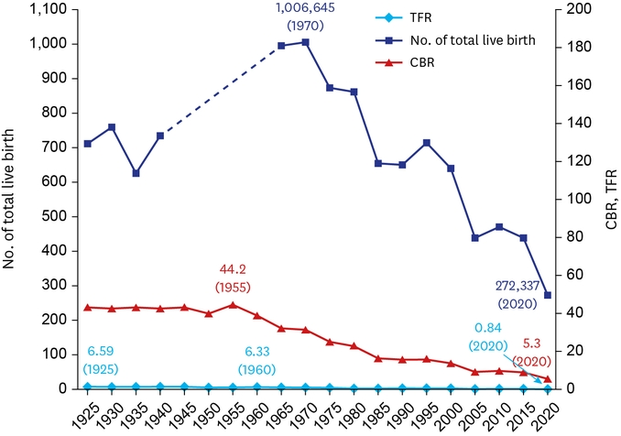
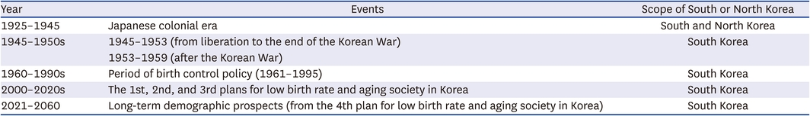
Literature Review
Birth Rate Transition in the Republic of Korea: Trends and Prospects (Yun et al., 2022)
Classified the data according to the historical events that could affect the population trends, i.e., Japanese colonial period, Korean War, liberation period, birth control policy
Notes:
As we can see in the graph and the table, there are a few historical events that have influenced South Korea’s fertility rate. For example, during the second world war, the population growth decreased due to exploitation and high infant mortality rate. Furthermore, the impact of the Korean War has lead to decline in fertility rate.These events indicates the trend of South Korea’s fertility rate and how it was formed starting from the Modern Era. It also differentiates from other OECD countries’ fertility rate.
These are some former researches that we found about changes in South Korea’s fertility rate.

Slide 9
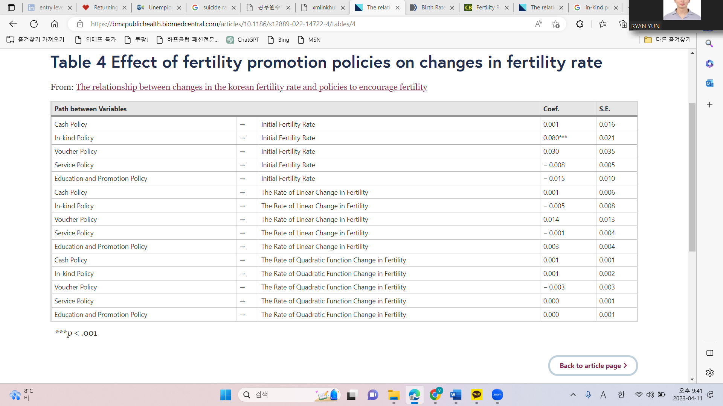
Literature Review
The Relationship Between Changes In The Korean Fertility Rate And Policies To Encourage Fertility (Jeong et al., 2022)
Utilized data of the total fertility rate of 250 local governments between 2014 and 2018, and a casebook of local government birth promotion policies
The higher the number of in-kind policies, the higher the fertility rate. On the other hand, cash policy, voucher policy, service policy, education and promotion policy did not affect the initial value of fertility rate
Notes:
According to this research, none of the policies from the executed by the local governments significantly affected the change in fertility rate. This signifies that the policies were not helping to bounce back the declining number.

Slide 10
02
Data Analysis
Notes:
Lucy
The next few slides will cover our data analysis.

Slide 11



Analysis Methods
SAS Visual Analytics, Google Colab, and Tableau used for data visualization and Python programming
OECD database used as a data source for analysis
Merging of multiple datasets into a single dataset
Application of machine learning algorithms for analysis
Statistical analysis performed on the merged dataset
Notes:
Lucy
In this project, we utilized several tools for data visualization and programming. We made use of SAS Visual Analytics, Google Colab, and Tableau to create visually appealing and insightful data visualizations. For data analysis, we sourced our data from the OECD database, which served as our primary data source. We merged multiple datasets into a single dataset to gain better insights and a more comprehensive understanding of the data. Additionally, we applied machine learning algorithms to further analyze the data and extract valuable insights. Lastly, we performed statistical analysis on the merged dataset to obtain meaningful conclusions and provide useful recommendations.

Slide 12
Analysis Methods (Continued)
We conducted our analysis using these methods:
Random Forest
Lasso Regression
Linear Regression
Notes:
Lucy
Our analysis was conducted using three methods: Random Forest, Lasso Regression, and Linear Regression.

Slide 13
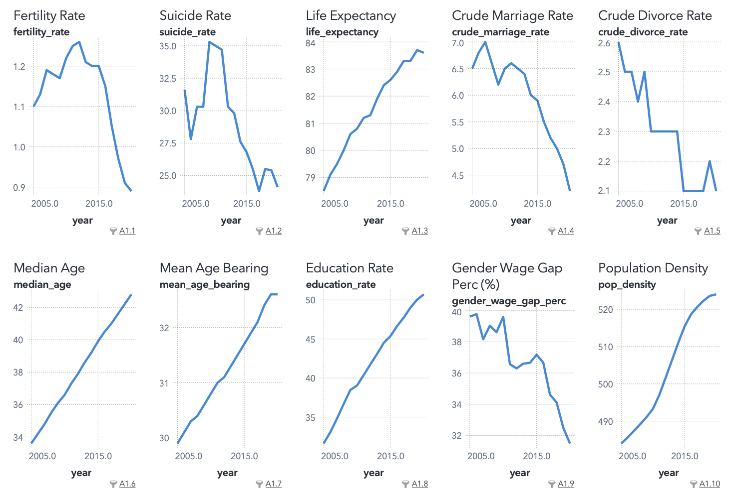
Statistics of South Korea
Graph presents a comparison of various factors obtained from the OECD database, focusing on South Korea and covering the time period from 2005 to the present day.
Notes:
Lucy
To kick off our analysis, we started by gaining a deeper understanding of the data from the OECD database, with a focus on South Korea. The data spans from 2005 to the present day. We evaluated multiple factors, and based on our visualizations, we found that there was a general decrease in fertility rate, crude marriage rate, crude divorce rate, and gender wage gap over time. In contrast, we noticed a significant increase in life expectancy, median age, median age bearing, education rate, and population density over the same period. While we won't delve into the specifics of each visualization, these trends give us a good idea of the overall picture and provide a starting point for our analysis.

Slide 14
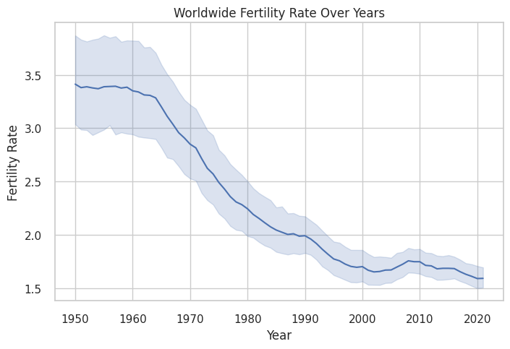
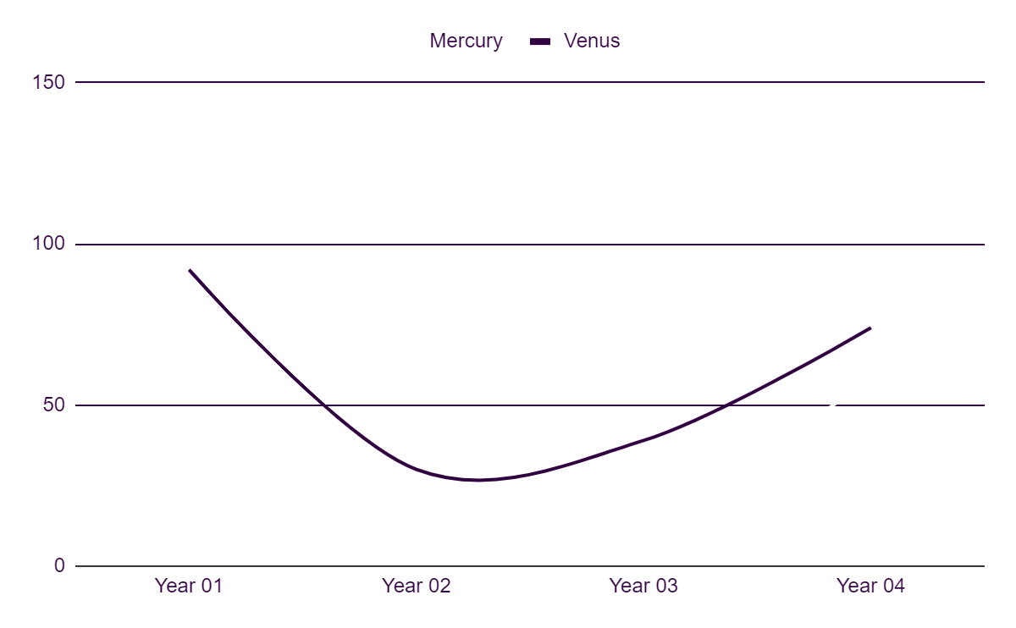
Global Fertility Rate
Global fertility rate has decreased over time from 1950 to the present date
In the 1950s, rates ranged from 3 to 4, whereas in 2020, rates range from 1.5 to 2
Notes:
Lucy
This graph shows the trend of worldwide fertility rate over time. The x-axis represents the years, while the y-axis represents the fertility rate. The decreasing trend of the fertility rate on the line plot suggests that the global fertility rate has decreased over time from 1950 to the present date. This insight can be valuable in understanding the changes in global population demographics over time.

Slide 15
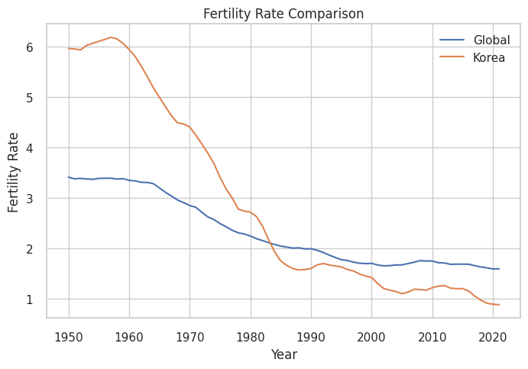
Fertility Rate Comparison
Global
Korea
Overall decline from 3.5 to 1.5, but fairly consistent in their downward trend
Significant decline from 6 to below 1, marked lower than the global average fertility rate
Notes:
Lucy
We conducted a comparison between the global fertility rate trend and that of South Korea. The graph shows that in 1950, South Korea's fertility rate was almost twice as high as the worldwide average, with an average fertility rate of 6 compared to the global average of 3.5. However, the fertility rate in South Korea experienced a significant decrease from 1950 to 1990, reaching a rate of 1.5. Currently, the fertility rate in South Korea is less than 1, which is significantly lower than the global average of between 1 and 2.

Slide 16
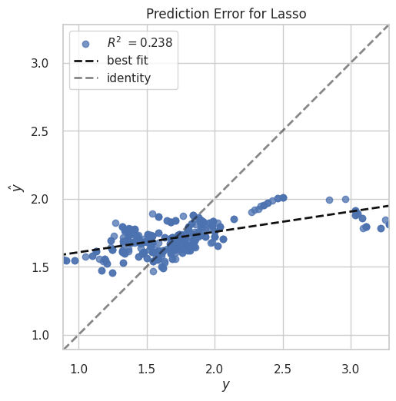
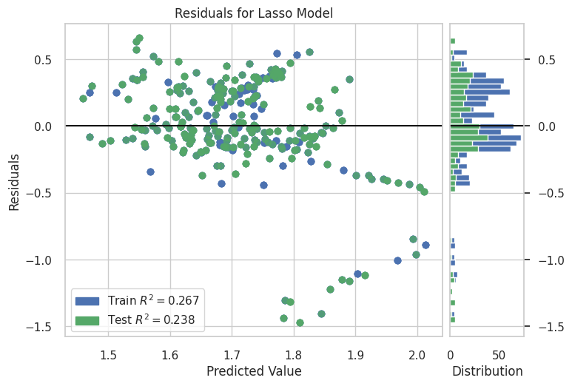
Lasso Regression
Notes:
We have chosen to run both Random Forest Regression Model and LASSO to identify the most important variables in predicting the decline in fertility rate and compare with each other.
However, our LASSO model only removed one variable from the model - life expectancy - and other variables seemed not highly correlated with each other, hence we chose to go with the Random Forest Regression Model instead.

Slide 17
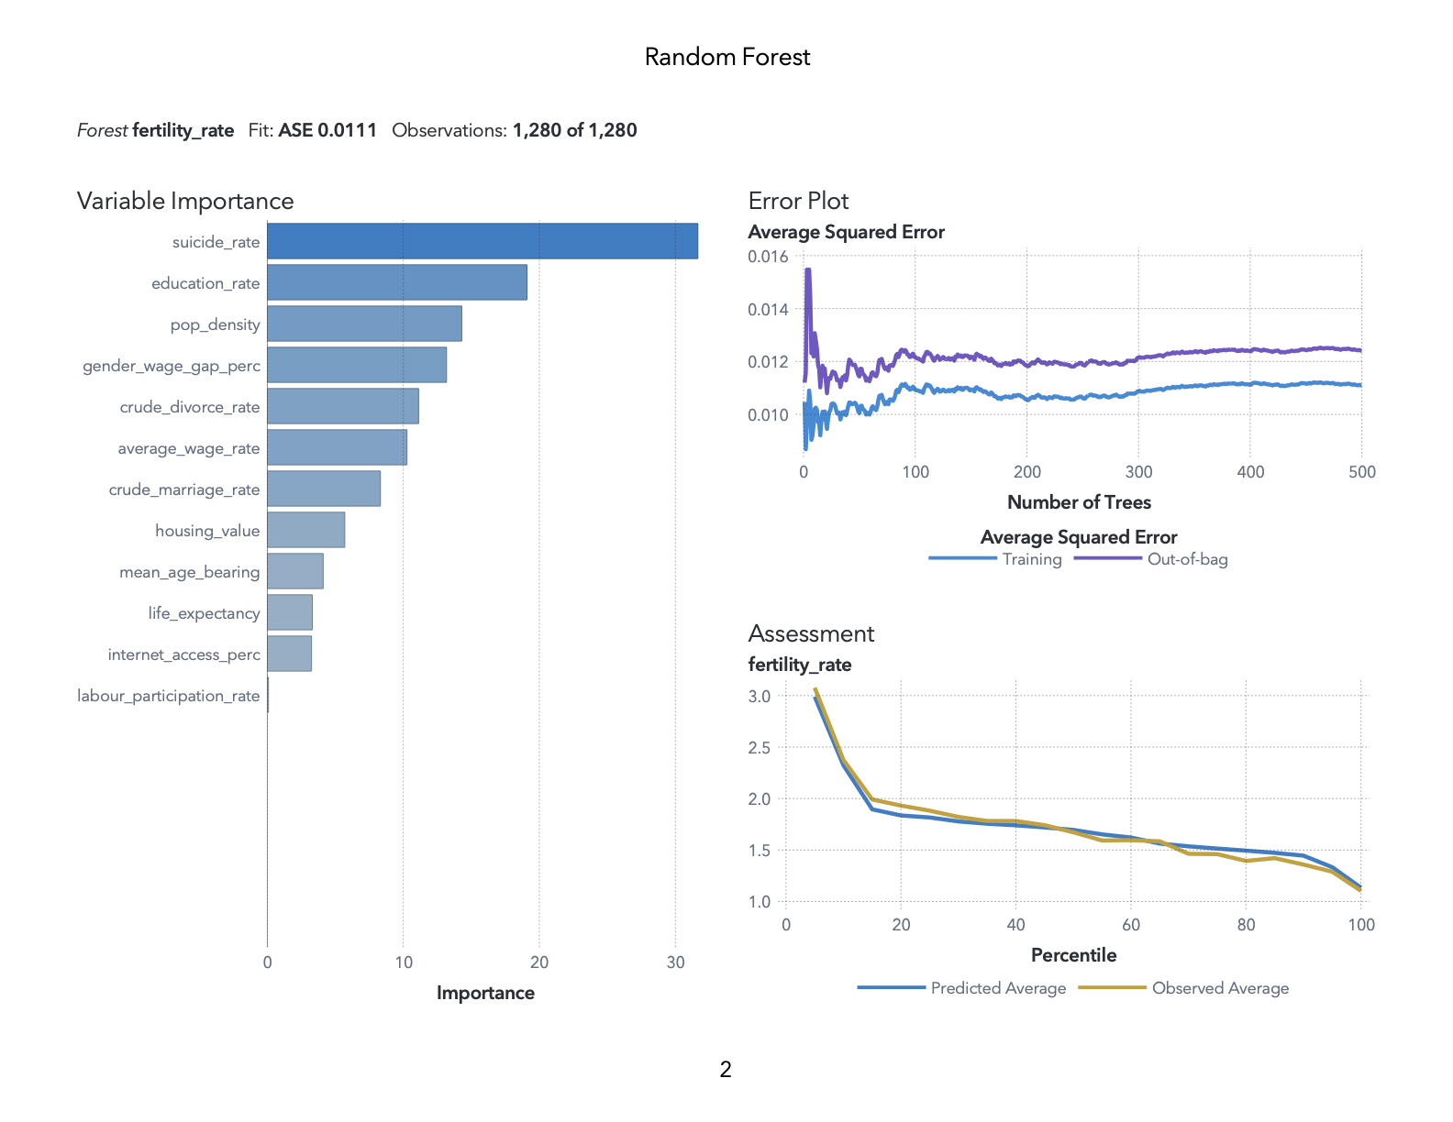
Random Forest Regression
Employed Random Forest to identify most important variables
Overwhelming importance of suicide rate in determining fertility rates
May reflect social and economic pressures that people face, discouraging people from having children
Notes:
The Random Forest feature importance chart shows us which variables tend to be selected by our trees the most. Our model was based on 500 trees. We found that the following five variables were the most important in predicting the decline in fertility rate, in descending order of variable importance:
Suicide Rate
Education Rate
Population Density
Gender Wage Gap Percentage
Crude Divorce Rate
Our results suggest that these factors are strongly related to the decline in fertility rate.
In particular, we see the overwhelming importance of suicide rate in determining fertility rates.
It is possible since the high suicide rate may reflect the social and economic pressures that people face living in sad country, which may discourage them from having children.

Slide 18
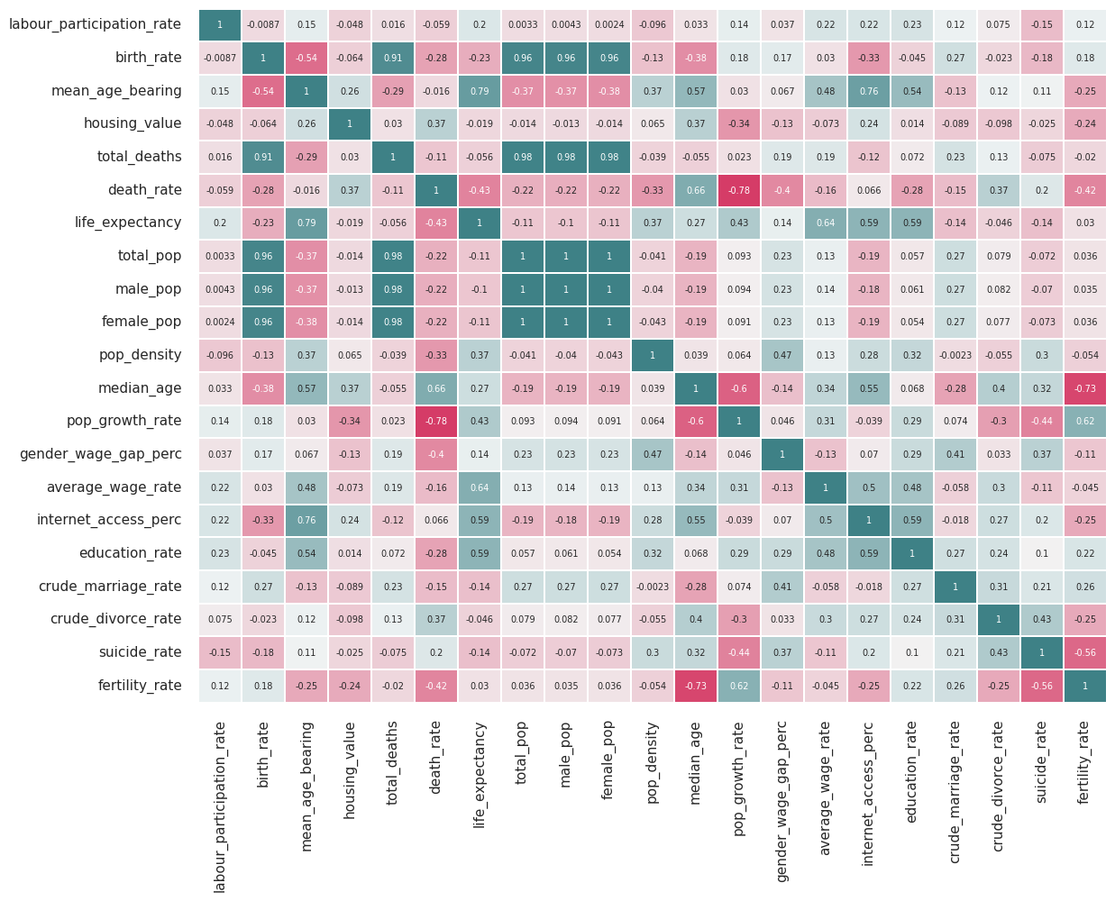
Correlation Matrix
Notes:
Federico
We explored many demographic, economic, and social factors that might affect fertility rate. From those we found, suicide rate seems to have a relationship regarding the decline of fertility rates among OECD countries since the year 2000. Suicide rate has a correlation of -0.56 which indicates that there is a high negative correlation between suicide rate and fertility rate.

Slide 19
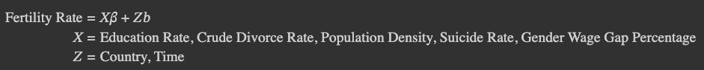
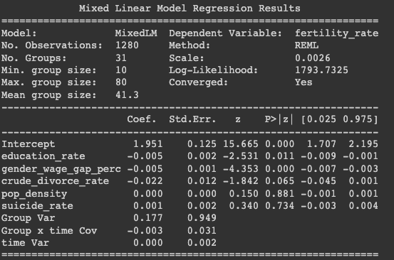
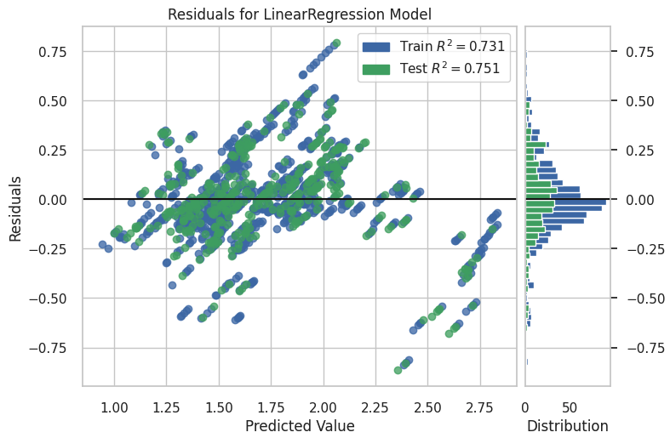
Linear Mixed Effects Model
Notes:
Federico
However Suicide rate seems to have little statistical significance with fertility rate, we recognize that there might be other confounders that affect both suicide rate and fertility rate such as overall quality of life.
We used the linear mixed effects model because we wanted to account for the inherent correlation of values of repeated observations for each country. We decided to use random effects and random slopes as countries have both different fertility rate averages, and also have different fertility rate trajectories.
We also recognize that the decision for bearing a child occurs before the actual time a child is born, so we believe that using lagged variables for all of these variables might be a useful way to further understand fertility rate patterns.

Slide 20
03
Our Findings

Slide 21
Study Results
Consistent decrease in South Korea's fertility rate since the 1950s, dropping from over 7 to just 0.78 births per woman. This decline is significant when compared to other OECD countries that are also struggling with low fertility rates
Clear correlation between South Korea's fertility rate and suicide rate, with the country recording the highest suicide rate among OECD countries at 24.1/100,000 persons
These results suggest that South Korea may be a particularly challenging and stressful country to live in, which could be contributing to the decline in fertility rates
Importance of policies aimed at addressing the factors identified as potential contributors to the decline in South Korea's fertility rate
Include reducing the gender wage gap and addressing the root causes of high suicide rates
By implementing targeted policies to tackle these issues, South Korea may be able to mitigate the decline in its fertility rate and improve overall well-being for its citizens
Notes:
Our study found that South Korea's fertility rate has consistently decreased since the 1950s, reaching from 7 to a low of 0.78 births per woman. This decline is particularly significant when compared to other OECD countries experiencing low fertility rates. We found a clear correlation between South Korea's fertility rate and its high suicide rate, Korea has the the highest among OECD countries at 24.1 per 100,000 persons. This suggests that South Korea may have underlying factors contributing to a sense of sadness or despair among its citizens. Our findings suggest that policies aimed at addressing the factors identified in our study, such as reducing suicide rates and addressing the gender wage gap, may help mitigate the decline in South Korea's fertility rate.

Slide 22

Suggestions
Based on our results, suicide rate is most associated with a low fertility rate
Factors that cause the high suicide rate in South Korea:
Social
High Level of Education = Proof of successful life
Low employment rate: Excessive people with high
education level = high competence in employment
Economical
High private education spending, housing prices, etc.
Possible Solutions:
Raising the quality of public education by spending more funds
Granting priority of national house sales to less financially stable families
Providing more blind recruitment during employment process
Notes:
Based on our results, we found that suicide rate is most associated with a low fertility rate. We recongnized that in order to mitigate low fertility rate, we have to deal with suicide rate as well.
Factors that cause high suicide rate in South Korea can be classified into social and economical ones. High level of education is considered as proof of successful life. Therefore, there are excessive people with high education level which means that there are too much competence in employment which results in low employment rate in South Korea.
Because of this social context, the spending of private education is formed at such high cost, putting general ordinary households in financial burden. Moreover, extremely high housing price is also a fatal problem in South Korea, which takes away people’s dream of managing their own house, leaving them with feeling of hopelessness.
There are several possible solutions to these problems even if it could not be implemented immediately.
Raising the quality of public education by spending more funds would lower the necessity of private education.
Granting priority on national house sales and child support could be very helpful to child-bearing families.
Lastly, providing more blind recruitment could standardize chance of employment regardless of education level.

Slide 23
Limitations
Underlying factors that cannot be easily quantified or measured
Example: Historical events, cultural attributes towards marriage and childbearing, changing gender roles and expectations, societal pressures, and personal preferences
Our study does not establish causation between identified factors and decline of fertility rate
Our study may contain selection and measurement biases that could affect the result accuracy
As the decision of bearing a child occurs before birth, we might want to also include lagged variables and see what its effects are on fertility
Notes:
There may be many underlying factors that contribute to South Korea's fertility rate declines that cannot be easily quantified or measured. These factors may include cultural attitudes towards marriage and childbearing, changing gender roles and expectations, societal pressures, and personal preferences. These factors can be complex and multidimensional, making it challenging to accurately account for them in a study. Additionally, there may be other factors that have yet to be identified or understood, highlighting the importance of ongoing research and analysis in this area.

Slide 24

Further Research
The South Korean government may utilize our analysis to inform policies that aims the factors identified in our study
Conduct more qualitative research to incorporate additional variables, such as underlying factors, and perform data analysis
Expand on our research, such as using lagged variables, and see the impacts on fertility rates
May use alternative methods, such as quasi-experimental designs, to establish causation
Notes:
The South Korean government may consider using our analysis aimed at mitigating the decline in fertility rate through targeting the factors that we have identified in our research.
To expand on our research, qualitative research could be conducted to explore underlying factors that cannot be easily quantified or measured.
Additionally, exploring lagged variables and the impacts on fertility rates could be an avenue for further investigation.
Lastly, alternative methods such as quasi-experimental designs could be used to establish causation and further understand the relationship between the identified factors and the decline in South Korea's fertility rate.

Slide 25
Thanks!
Team K-Analysts | Victor Ahn, Federico Chung, Sebin Lee, Yongjung Lee, Jangwon Yun

Slide 26
Resources
Jeong, K., Yoon, J., Cho, H. J., Kim, S., & Jang, J. (2022). The Relationship Between Changes In The Korean Fertility Rate And Policies To
Encourage Fertility. BMC Public Health, 22(1), 2298. https://doi.org/10.1186/s12889-022-14722-4
Kim, A. M. (2020). Factors Associated With The Suicide Rates In Korea. Psychiatry Research, 284(112745), 112745.
https://doi.org/10.1016/j.psychres.2020.112745
OECD (2023), "Family Indicators", OECD Social and Welfare Statistics (database), https://doi.org/10.1787/efd30a09-en (accessed on 12
April 2023).
OECD (2023), Fertility rates (indicator). doi: 10.1787/8272fb01-en (Accessed on 11 April 2023)
OECD (2023), Housing prices (indicator). doi: 10.1787/63008438-en (Accessed on 11 April 2023)
OECD (2023), Internet access (indicator). doi: 10.1787/69c2b997-en (Accessed on 11 April 2023)
OECD (2023), Spending on tertiary education (indicator). doi: 10.1787/a3523185-en (Accessed on 11 April 2023)
OECD (2023), Suicide rates (indicator). doi: 10.1787/a82f3459-en (Accessed on 11 April 2023)
United Nations, Department of Economic and Social Affairs, Population Division (2022). World Population Prospects 2022, Online Edition.
Yun, J., Kim, C. Y., Son, S. H., Bae, C. W., Choi, Y. S., & Chung, S. H. (2022). Birth Rate Transition in the Republic of Korea: Trends and
Prospects. Journal of Korean medical science, 37(42), e304. https://doi.org/10.3346/jkms.2022.37.e304

